Slide 1

Optimization
Home
About
Content
Others
Container 2D Loading Minimize Cost
A mini project developed by group 9
Class ID: 152625
Course ID: IT3052E
Grading teacher: Bùi Quốc Trung

Slide 2

Optimization
Home
About
Content
Others
Meet the team
Lương Xuân Nguyên
Chu Anh Đức
Nguyễn Đức Kiên
Trần Tiến Sơn
20230081
20235597
20230088
20235620

Slide 3

Optimization
Home
About
Content
Others
Table of contents
1. Introduction
2. Modeling
3. Results and Analysis
4. Visualization
5. Conclusion
6. Contributions

Slide 4



Optimization
Optimization
Home
About
Content
Others
1. Introduction
There are 𝐾 trucks 1,2,…,𝐾
Truck 𝑘 has the container size 𝑊[𝑘] × 𝐿[𝑘] with the cost 𝑐[𝑘]
1.1 Problem description
There are 𝑁 items 1, 2, ..., 𝑁
Item 𝑖 has the size of 𝑤[𝑖] × 𝑙[𝑖]
Constraints:
All the items placed in the same truck can’t overlap
Each item can be rotated by 90 degree
Find a solutions that loads all the items into the given trucks such that the total cost of trucks used is minimal

Slide 5

Optimization
Home
About
Content
Others
1. Introduction
Phase 1: 40 tests
11 ≤ n, k ≤ 50
50 ≤ 𝑤[𝑖], 𝑙[𝑖] ≤ 250
100 ≤ 𝑊[𝑘] × 𝐿[𝑘] ≤ 400; 100 ≤ 𝑐[𝑘] ≤ 500
1.2 Input Preparation
We generate the inputs by splitting into 3 phases
With each phase being more complicated than the last
Phase 3: 40 tests
500 ≤ n, k ≤ 1000
10 ≤ 𝑤[𝑖], 𝑙[𝑖] ≤ 1000
10 ≤ 𝑊[𝑘] × 𝐿[𝑘] ≤ 1000; 100 ≤ 𝑐[𝑘] ≤ 1000
Phase 2: 60 tests
100 ≤ n, k ≤ 300
50 ≤ 𝑤[𝑖], 𝑙[𝑖] ≤ 250
100 ≤ 𝑊[𝑘] × 𝐿[𝑘] ≤ 400; 100 ≤ 𝑐[𝑘] ≤ 500

Slide 6







Xij = 1
Optimization
Home
About
Content
Others
2. Modelling
2.1.1 Decision variables
Xij = 1: item i packed in bin j
2.1 CP model
$→\sum_{i=1}^{N_items}{Xij }≥1 ↔ Z\text{j}=1$: bin j has been used
R_{i} = 1: item i is rotated 90$°$
R_{i} = 0: item i is not rotated
li, ri, bi, ti : left, right, bottom and top coordinates of item i
$$ti$$
$$→\left\{\begin{aligned}ri=l_{i}+w_{i} \\ ti=b_{i}+h_{i}\end{aligned}\right.$$
if item i not rotated: R_{i} = 0
$$bi$$
$$→\left\{\begin{aligned}ri=l_{i}+h_{i} \\ ti=b_{i}+w_{i}\end{aligned}\right.$$
if item i rotated: R_{i} = 1
$$li$$
$$ri$$

Slide 7






Optimization
Home
About
Content
Others
2. Modelling
2.1.3 Objective function
2.1.2 Constraints
Each item must be packed in exactly 1 truck
$$\sum_{i=1}^{K}{Zi∗Ci}$$
$$\sum_{j=1}^{K}{Xij=1, ∀ i ∈\{1, 2…, N_items\}}$$
min
Items can not overlap each other if
$$X_{i_{1}j} =X_{i_{2}j}= 1$$
then $r_{i_{1}}≤ l_{i_{2}}$ or $r_{i_{2}}≤ l_{i_{1}}$ or $t_{i_{1}}≤ b_{i_{2}}$ or $t_{i_{2}}≤b_{i_{1}}$
Items can not exceed the truck if $Xij=1$
$→\left\{\begin{aligned}wi≤ri≤Wj \\ hi≤ti≤Hj\end{aligned}\right.$

Slide 8





Xij = 1
Optimization
Home
About
Content
Others
2. Modelling
2.2.1 Decision variables
Xij = 1: item i packed in bin j
2.2 MIP model
$→\sum_{i=1}^{N_items}{Xij }≥1 ↔ Z\text{j}=1$: bin j has been used
R_{i} = 1: item i is rotated 90$°$
R_{i} = 0: item i is not rotated
li, ri, bi, ti : left, right, bottom and top coordinates of item I
$$ti$$
$$→\left\{\begin{aligned}ri=l_{i}+w_{i} \\ ti=b_{i}+h_{i}\end{aligned}\right.$$
if item i not rotated: R_{i} = 0
$$→\left\{\begin{aligned}ri=l_{i}+h_{i} \\ ti=b_{i}+w_{i}\end{aligned}\right.$$
if item i rotated: R_{i} = 1
$$bi$$
$$li$$
$$ri$$

Slide 9
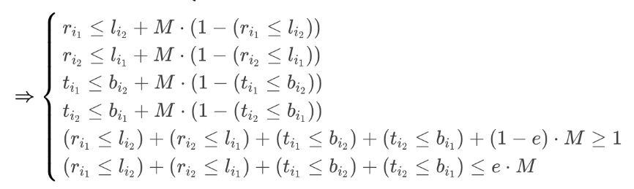
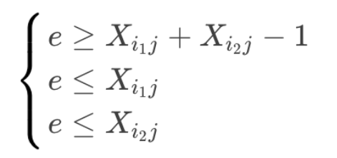



Optimization
Home
About
Content
Others
2. Modelling
Items can not exceed the truck if $Xij=1$
$→\left\{\begin{aligned}ri≤\left(1 −Xij\right)∗M+Wj \\ ti≤\left(1 − Xij\right)∗M+Hj\end{aligned}\right.$
2.2.2 Constraints
Each item must be packed in exactly 1 truck
$$\sum_{j=1}^{K}{Xij=1, ∀ i ∈\{1, 2…, N_items\}}$$
2.2.3 Objective Function
$$\sum_{i=1}^{K}{Zi∗Ci}$$
min
Items can not overlap each other
Create new variable e such that

Slide 10
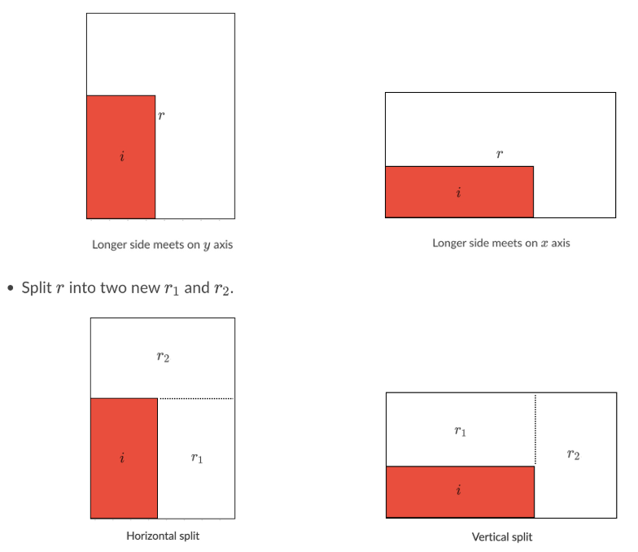
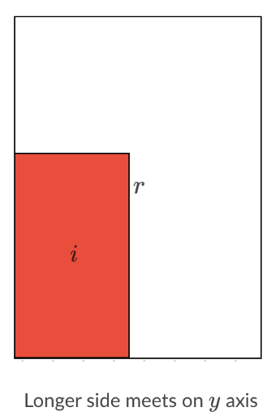
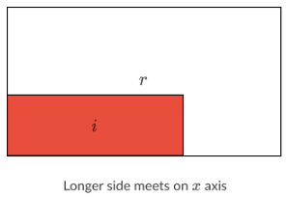
Xij = 1
Optimization
Home
About
Content
Others
2. Modelling
2.3 Heuristic
2.3.1 Sort the items
We sort N items with
Longer Side First Order
Decreasing order of the longer side of items
If the longer sides are equal, follow he decreasing order of the shorter side
Decreasing order of the longer side of items
If the longer sides are equal, follow he decreasing order of the shorter side

Slide 11
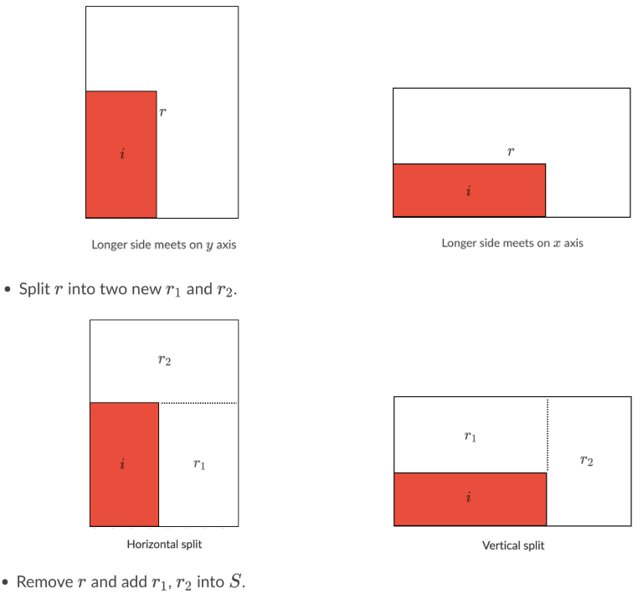
Xij = 1
Optimization
Home
About
Content
Others
2. Modelling
2.3.2 items placing method
Initially, we maintain a set S of “empty rectangles” for a truck k. At first the set contains (Wk, Lk). At each step, choose an item I (in the sorted list)
Place item i at the bottom-left corner of the smallest “empty rectangle” r which is in S
If there is no r that can fit i, let the other trucks handle it
Rotation of I based on the longer side of i and r (the longer side of i match the longer side of r)

Slide 12

Xij = 1
Optimization
Home
About
Content
Others
Find the minimum total cost using this basic greedy algorithm
2. Modelling
For each pair (truck[k], item[i]) check whether item[i] can be placed in truck[k] or not using the algorithm in 2.3.2
If item[i] can not be placed into truck[k], leave it to use later
Calculate the total cost
2.3.3 Basic Greedy
Among all the following order of trucks
Decrease order of longer side
Decrease order of area
Increase order of cost
Increase order of $\frac{cost}{area}$

Slide 13
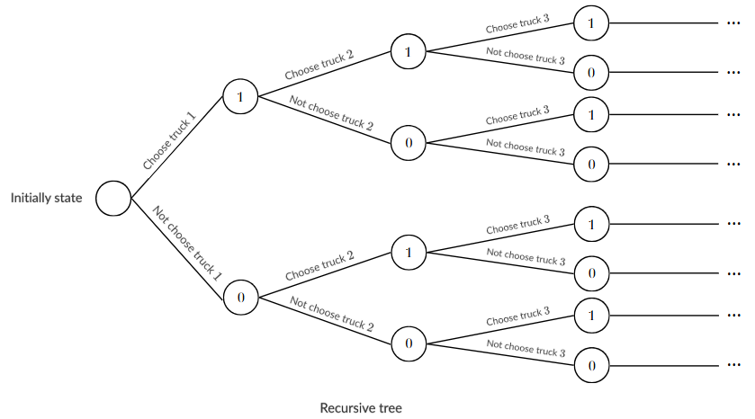
Xij = 1
Optimization
Home
About
Content
Others
A simple approach is to generate a binary sequence using recursion
2. Modelling
2.3.4 Branch and Bound
Since each truck k from 1 to K is either chosen or not chosen. We conduct an algorithm that process on a binary sequence
Among all the following order of trucks

Slide 14
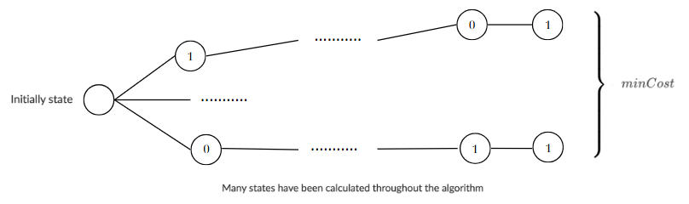
Xij = 1
Optimization
Home
About
Content
Others
At a single state of a binary sequence b, calculate whether all the trucks i (i is the position of bit 1 in b)can place all of n items or not. If so, update the minCost with totalCost
2. Modelling
2.3.4 Branch and Bound
Among all the following order of trucks

Slide 15
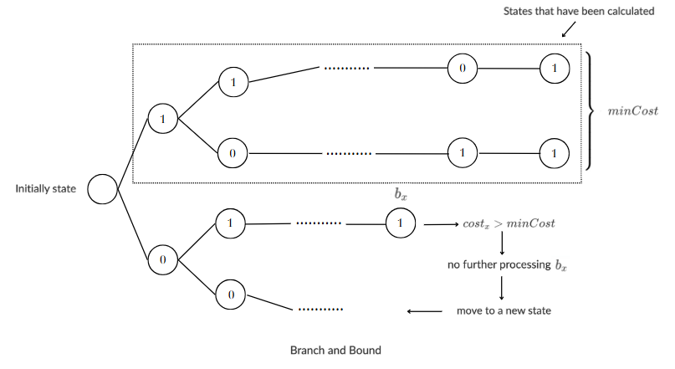
Xij = 1
Optimization
Home
About
Content
Others
2. Modelling
2.3.4 Branch and Bound
Assume that there is a substate which has the totalCost > minCost
→ We don’t need to continue the process
Among all the following order of trucks

Slide 16
Optimization
Home
About
Content
Others
3. Results and Analysis

Slide 17
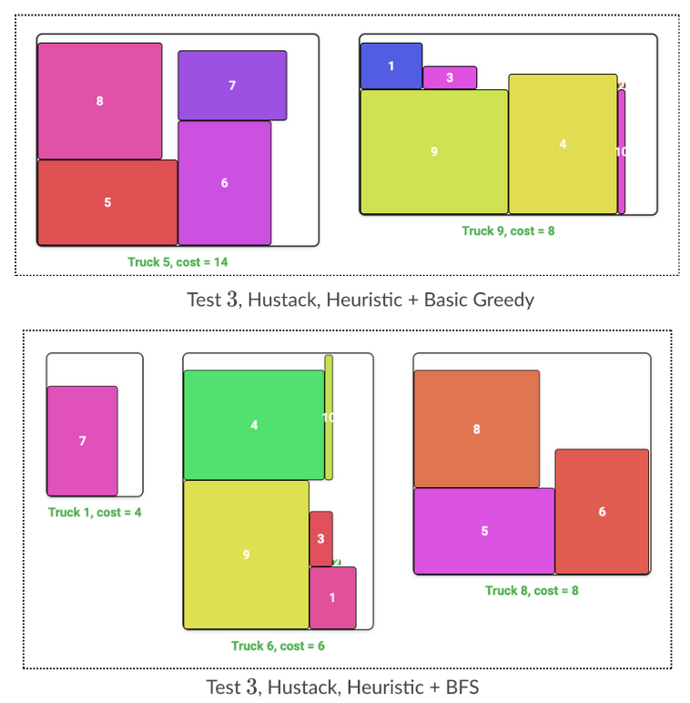
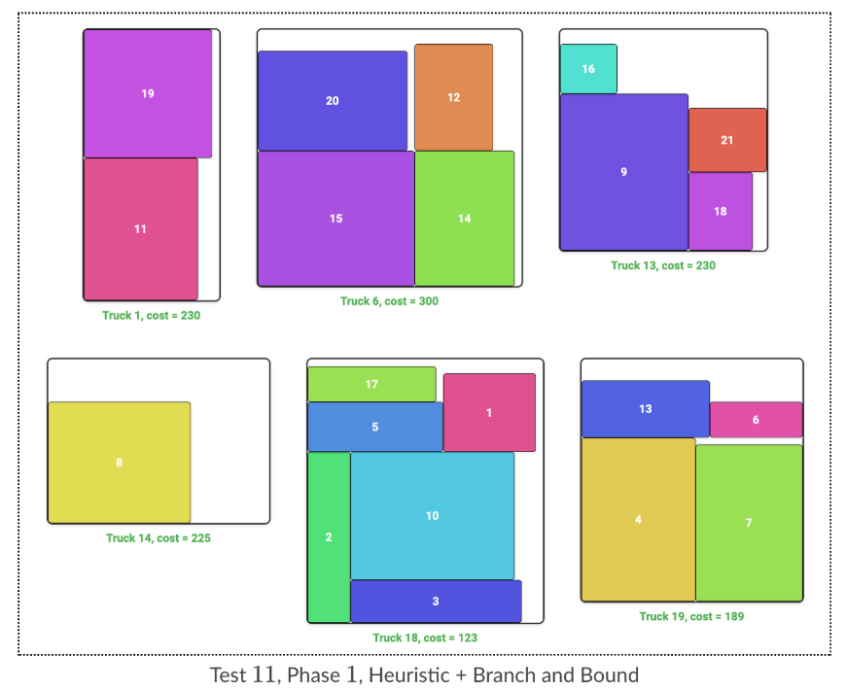
Optimization
Home
About
Content
Others
4 .Visualization

Slide 18
Optimization
Home
About
Content
Others
5. Conclusion
In conclusion, based on our evaluation
The Heuristic algorithm is highly accurate and efficient, making it a valuable tool for practical applications that require both accuracy and speed
The CP solver is also a viable alternative, particularly for smaller data sets
The MIP solver consistently performs poorly and is not recommended

Slide 19
Optimization
Home
About
Content
Others
6. Contributions
Lương Xuân Nguyên
Chu Anh Đức
Nguyễn Đức Kiên
Trần Tiến Sơn
20230081
20235597
20230088
20235620
CP solver
Analyze and draw graphs from the inputs and outputs
Heuristic solver
Generate input with varying levels of difficulties
Heuristic solver
Work with the entire team to write a report
MIP solver
Create the presentation through the report

Slide 20
Optimization
Home
About
Content
Others
Thank You
-

Slide 21
Optimization
Home
About
Content
Others
3. Results and Analysis

Slide 22
Optimization
Home
About
Content
Others
2. Modelling
2.1.3 Objective function
2.1.2 Constraints
Each item must be packed in exactly 1 truck
$$\sum_{i=1}^{K}{Zi∗Ci}$$
$$\sum_{j=1}^{K}{Xij=1, ∀ i ∈\{1, 2…, N_items\}}$$
min
Items can not overlap each other if
$$X_{i_{1}j} =X_{i_{2}j}= 1$$
then $r_{i_{1}}≤ l_{i_{2}}$ or $r_{i_{2}}≤ l_{i_{1}}$ or $t_{i_{1}}≤ b_{i_{2}}$ or $t_{i_{2}}≤b_{i_{1}}$
Items can not exceed the truck if $Xij=1$
$→\left\{\begin{aligned}wi≤ri≤Wj \\ hi≤ti≤Hj\end{aligned}\right.$

Slide 23
Xij = 1
Optimization
Home
About
Content
Others
2. Modelling
2.1.1 Decision variables
Xij = 1: item i packed in bin j
2.1 CP model
$→\sum_{i=1}^{N_items}{Xij }≥1 ↔ Z\text{j}=1$: bin j has been used
R_{i} = 1: item i is rotated 90$°$
R_{i} = 0: item i is not rotated
li, ri, bi, ti : left, right, bottom and top coordinates of item i
$$ti$$
$$→\left\{\begin{aligned}ri=l_{i}+w_{i} \\ ti=b_{i}+h_{i}\end{aligned}\right.$$
if item i not rotated: R_{i} = 0
$$bi$$
$$→\left\{\begin{aligned}ri=l_{i}+h_{i} \\ ti=b_{i}+w_{i}\end{aligned}\right.$$
if item i rotated: R_{i} = 1
$$li$$
$$ri$$

Slide 24
Thynk Unlimited
Home
About
Content
Others
Programming Concepts and Logic
At the core of programming are concepts like variables, loops, functions, and conditional statements. These elements form the logic that drives a program, allowing it to make decisions, process data, and perform tasks. Mastering these basics is essential for programmers to create reliable and efficient code.

Slide 25

Thynk Unlimited
Home
About
Content
Others
Problem-Solving
with Code
Programming is fundamentally about problem-solving. A programmer analyzes a problem, designs a solution, and writes code to implement it.

Slide 26

Thynk Unlimited
Home
About
Content
Others
Programming often requires collaboration, especially in large projects. Developers use version control tools like Git to manage code, allowing multiple programmers to work on the same project seamlessly.
Collaboration in Programming
Working Together in Code

Slide 27
Thynk Unlimited
Home
About
Content
Others
Testing and Debugging
Testing and debugging are crucial steps in programming. Testing verifies that code functions as expected, while debugging identifies and resolves errors. By carefully testing and refining code, programmers ensure their applications are reliable, user-friendly, and free of bugs, enhancing the end-user experience.
Working Together in Code

Slide 28
Thynk Unlimited
Home
About
Content
Others
AI, Automation, and Beyond
The future of programming is evolving with advancements in artificial intelligence, machine learning, and automation. As programming languages and tools become more sophisticated, programmers can tackle complex tasks more efficiently. These developments open up new opportunities for innovation, shaping the way we interact with technology.
Thynk Unlimited
The Future of Programming

